Slide 1

INTERNET OF THINGS HARDWARE

Slide 2
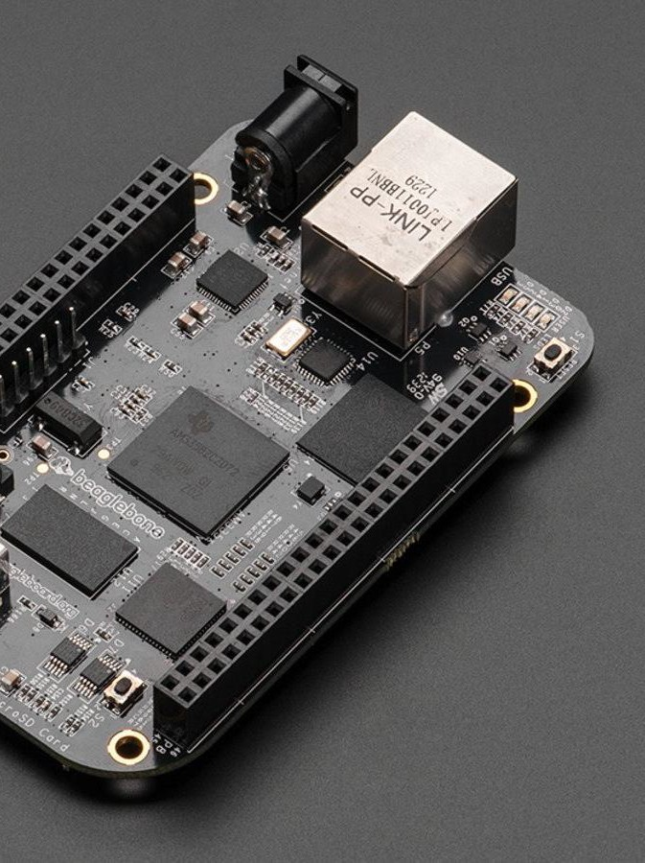
CONTENT OUTLINE
Microcontrollers vs. Computers
Good for sensors Good for sensors and processing Good for processing and network Ethernet vs. ESP8266 -01 Introduction: Esp8266 node-MCU
Esp8266: Pinouts

Slide 3
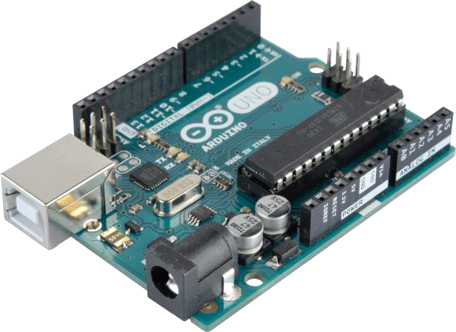
MICROCONTROLLER
vs. COMPUTERS
Simple Build Systems Control hardware Low speeds
Small memory
GPIO PWM ADC
Run single software (Bootloader)

Slide 4
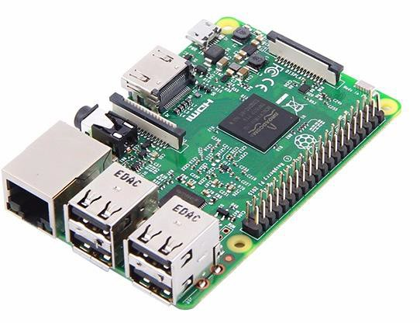
MICROCONTROLLER
vs. COMPUTERS
Embedded CPUs
High Ram High Speed
Large Memory with extendable size Modest in controlling hardware GPIO
Run on OS
No real time execution

Slide 5
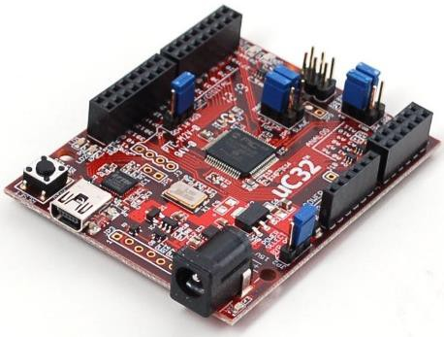
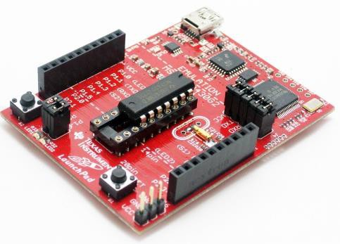
I.
GOOD FOR THE SENSORS
ARDUINO
ATMega 328P
ChipKIT
PIC Controller
LaunchPad
MSP430

Slide 6
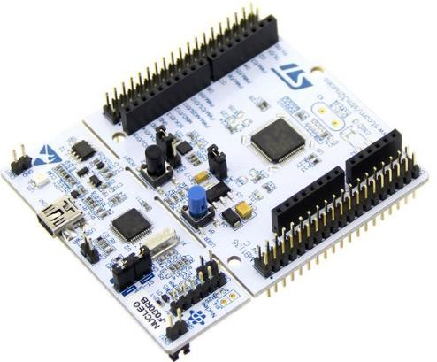
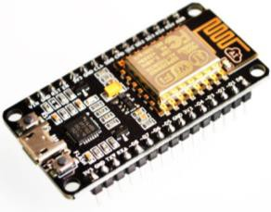
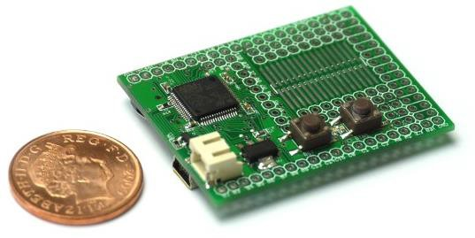
II.
STM32
STM Nucleo
ARM Cortex M
GOOD FOR SENSORS
& PROCESSING
ESP8266 node-MCU
Espressif ESP8266
WiFi Module
ESPRUINO
ARM
Javascript

Slide 7

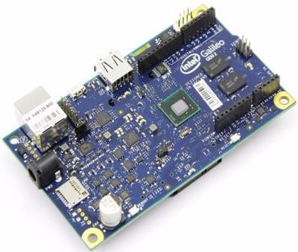
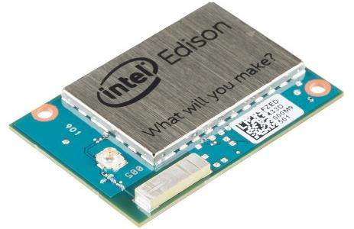
III.
GOOD FOR PROCESSING
& NETWORK
Raspberry PI CPU Module 900MHz ARM
OS Environment 1 GB RAM
Intel-Galileo
400 MHz Quark x86
256 MB RAM
Intel Edision
1GHz Dual Core Atom X86
WiFi, 4GB Flash

Slide 8
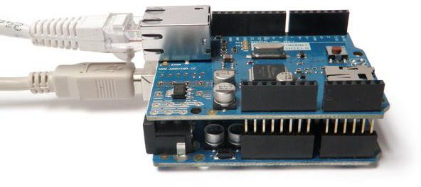
ESP8266 Wi-Fi
vs.
ETHERNET MODULE
Small programmable device
Easily connectable
Open source
Has a simple to use software Only around four simultaneous networking connections

Slide 9
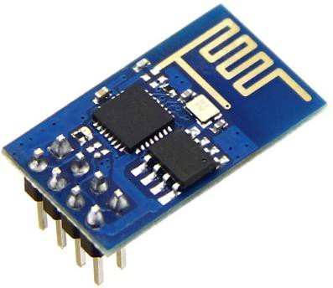
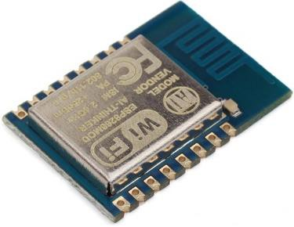
ESP8266 Wi-Fi
vs.
ETHERNET MODULE
802.11 b/g/n
Wi-Fi Direct (P2P), soft-AP Integrated TCP/IP protocol stack Programmable GPIO
1MB Flash Memory
Integrated low power 32-bit CPU could be used as application processor SPI, UART

Slide 10
ESP8266 -01

Slide 11

INTRODUCTION: ESP8266 - 01
An open-source firmware and development kit that helps you to prototype your IOT product within a few Lua/C++ script lines.
Arduino-like hardware IO
Node-JS style network API
Lowest cost WI-FI

Slide 12
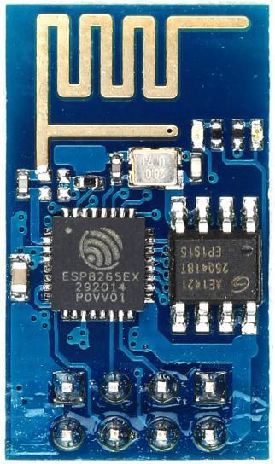
INTRODUCTION: ESP8266 - 01

Slide 13
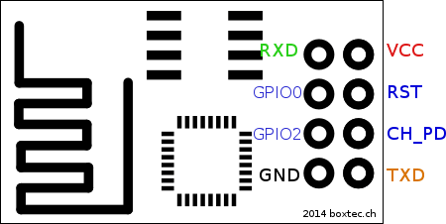
Esp8266 - 01 PINOUTS
2 Digital Pinouts: GPIO1 GPIO2
USART: RXD TXD
Power Supply VCC – 3.3V CH_PD – 3.3V GND
Programming via Rx-Tx FTDI USB

Slide 14

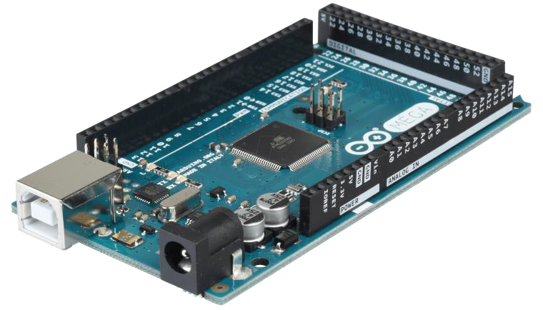
THE THING
ARDUINO MEGA

Slide 15
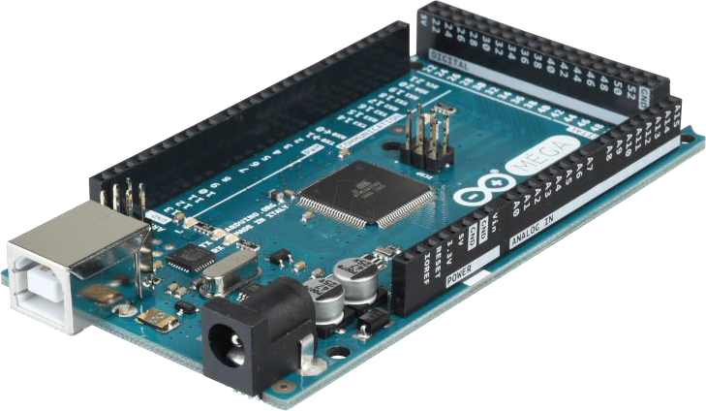
INTRODUCTION:
ARDUINO
ARDUINO is an open-source Electronics Prototyping Platform based on easy – to – use hardware & software. It’s intended for anyone making interactive projects.

Slide 16
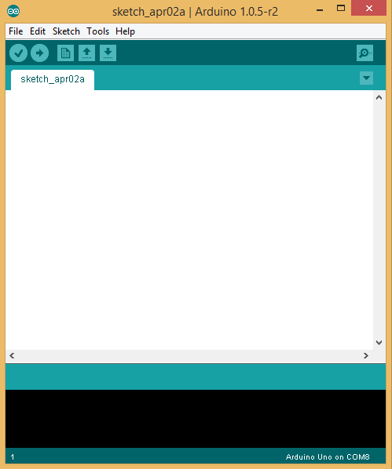
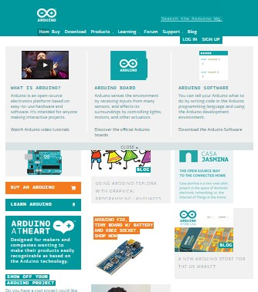
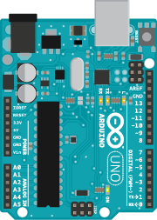
ARDUINO ECOSYSTEM
BOARD
SOFTWARE
COMMUNITY

Slide 17
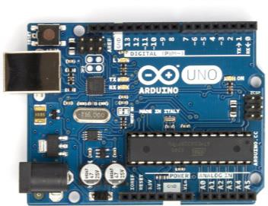
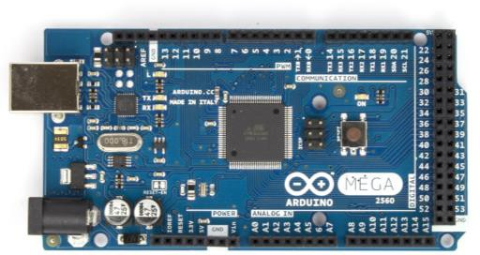
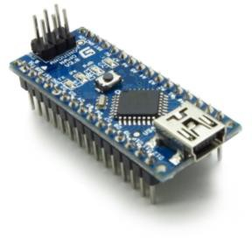
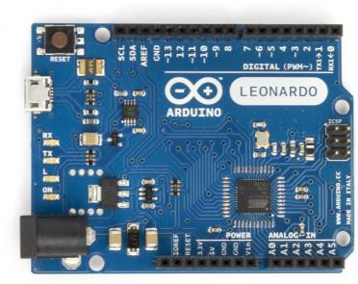
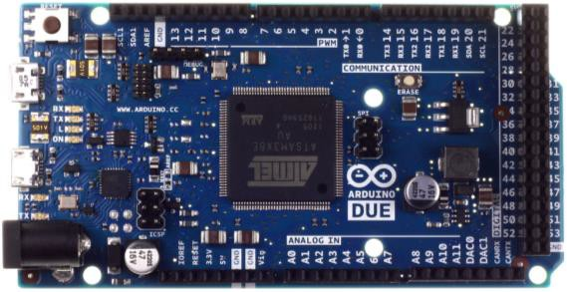
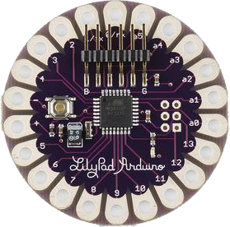
ARDUINO FLAVOURS

Slide 18
ARDUINO MEGA MICROCONTROLLER

Slide 19
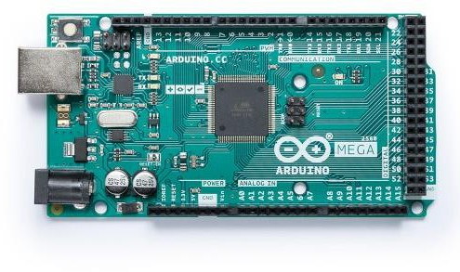

Slide 20
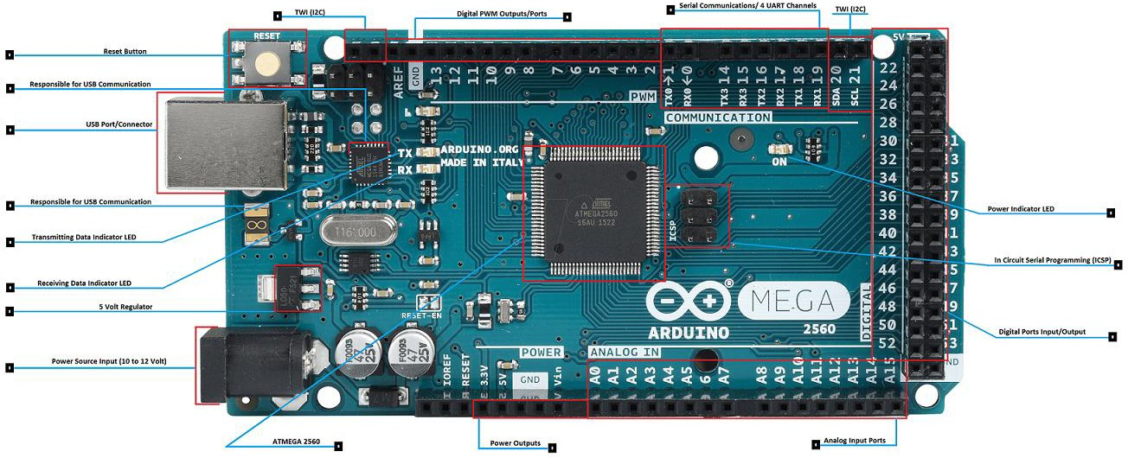

Slide 21
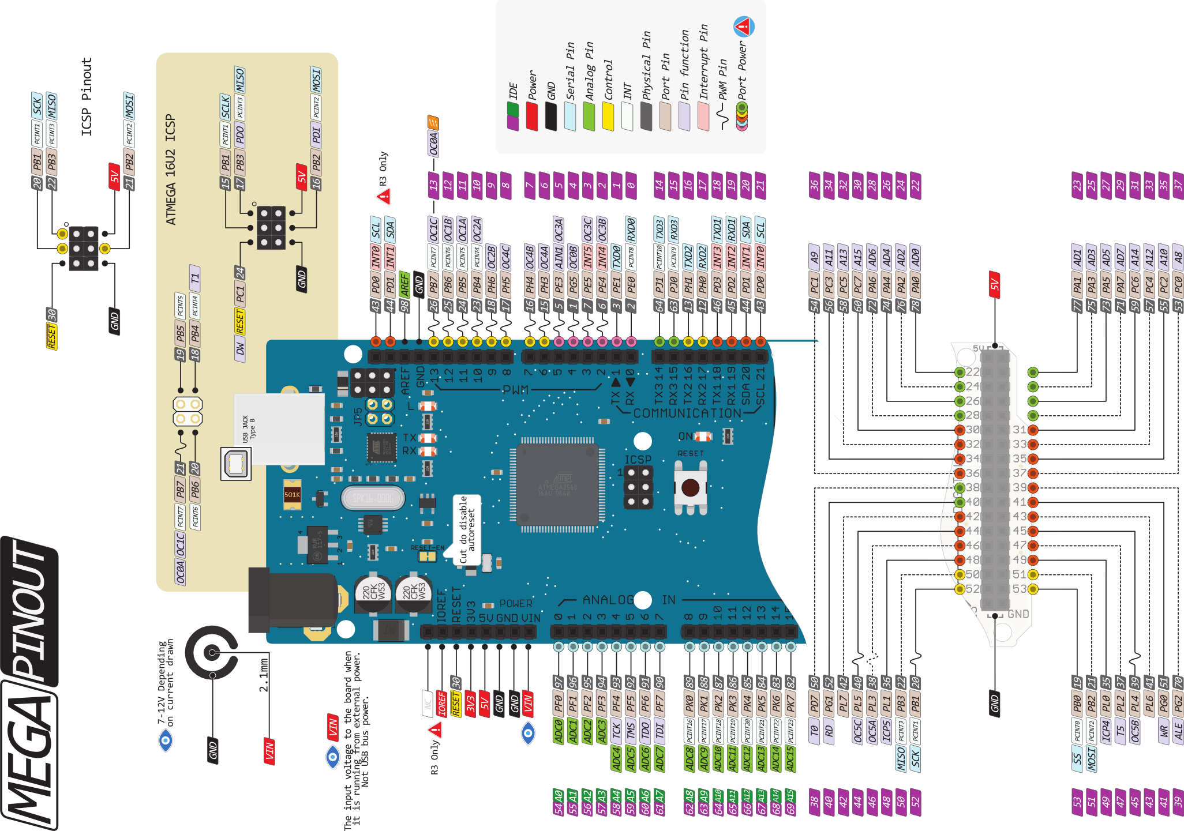

Slide 22
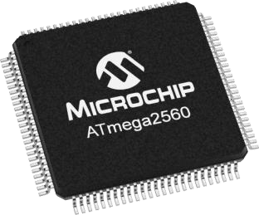
INTRODUCTION: ATMEGA 2560
Atmel ATMega 2560 is the heart of MEGA version Arduino.
This TQFP microcontroller features 16 MIPS throughput
capability at 16MHz CRYSTAL.
I/O :
Digital Ports: Total 54 I/O Pins.
ADC Pins : A0 to A15
USART: PD0 (RXD) PD1(TXD)
PWM: 15 out of 54 Digital I/O can be used as PWM outputs
Power: Chip operates in between 1.8V to 5.5V

Slide 23
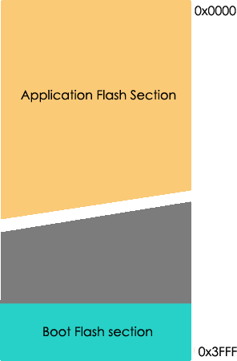
ARDUINO MEMORY
FLASH:
In system reprogrammable non-volatile program space storage is 256KB.
A separate memory space partitioned for Boot Flash section
of 8KB.
SRAM:
Temporary values, stack of volatile type memory, memory size 8KB
EEPROM:
4KB of space availability storage space for long-term.

Slide 24
ATMEGA 2560
FEATURES
TIMER:
Two 8-bit Timer/Counters with Separate Prescaler and Compare Mode Four 16-bit Timer/Counter with Separate Prescaler, Compare- and Capture Mode
PWM:
Four 8-bit PWM Channels
Twelve PWM Channels with Programmable Resolution from 2 to 16 Bits
USART:
Four Programmable Serial USART
ADC:
16-channel, 10-bit ADC

Slide 25
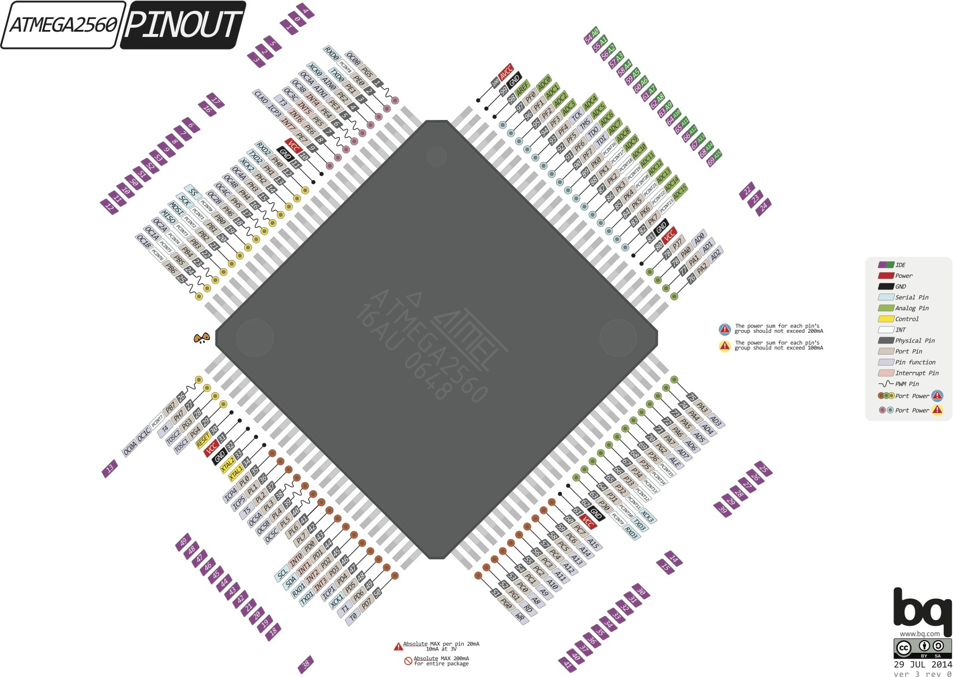
ARDUINO: PIN DIAGRAM

Slide 26
HAPPY LEARNING…

Slide 27

THANK YOU

